Slide 1
Encapsulation
Presentation by group 8:
Sourav B. Tile
Aakanksha S. Khairnar
Akash D. Sangle
Prasad V. Sonawane
Abhijeet P. Pawar
Prasad G. Ahire
Harshal Y. Sarode
Sanjeev Deshmukh

Slide 2
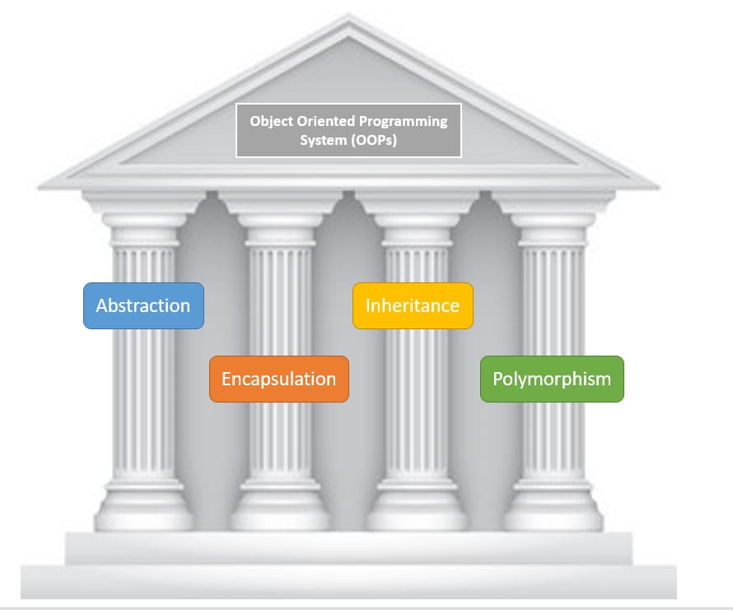
Introduction to OOPS

Slide 3
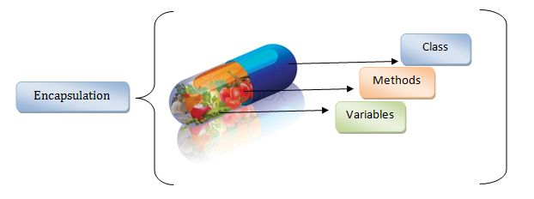
Definition of Encapsulation:
Encapsulation is defined as the wrapping up of data and information in a single unit. In Object Oriented Programming, Encapsulation is defined as binding together the data and the functions / methods.

Slide 4
In Encapsulation refers to the binding of data with the methods that operate on the data. It may also refer to the limiting of direct access to some of that data, such as an object’s components. In essence, encapsulation is about keeping the internal workings of an object hidden from the outside world, and only exposing what is necessary. This helps in maintaining the integrity of the data and makes the code more manageable.

Slide 5
Real life example :
A bank account is a great example of encapsulation as it bundles several pieces of data (like the account number, the account holder’s name, and the balance) and methods (like deposit, withdraw, and check balance) into a single unit (the account).
The data in the account is private - for example, you can’t directly change the balance of your account. Instead, you have to use the provided methods: you can deposit money into your account, which increases your balance, or withdraw money from your account, which decreases your balance. You can also check your balance using another method.
This is similar to how encapsulation works in programming. The data (in this case, the balance) is kept private and can only be accessed or modified using the provided methods (deposit, withdraw, check balance). This prevents the data from being modified in unexpected ways - for example, it prevents the balance from being set to an arbitrary value.

Slide 6
Two Important property of Encapsulation:
Data Protection: Encapsulation protects the internal state of an object by keeping its data members private. Access to and modification of these data members is restricted to the class’s public methods, ensuring controlled and secure data manipulation.
Data Hiding: Encapsulation hides the internal implementation details of a class from external code. Only the public interface of the class is accessible, providing abstraction and simplifying the usage of the class while allowing the internal implementation to be modified without impacting external code.

Slide 7
Features of Encapsulation:
We can not access any function from the class directly. We need an object to access that function that is using the member variables of that class.
The function which we are making inside the class must use only member variables, only then it is called encapsulation.
If we don’t make a function inside the class which is using the member variable of the class then we don’t call it encapsulation.
Encapsulation improves readability, maintainability, and security by grouping data and methods together.
It helps to control the modification of our data members.

Slide 8
Roles of Access Specifiers in Encapsulation:
Private: Private access specifier means that the member function or data member can only be accessed by other member functions of the same class.
Protected: A protected access specifier means that the member function or data member can be accessed by other member functions of the same class or by derived classes.
Public: Public access specifier means that the member function or data member can be accessed by any code.

Slide 9
Example1 :
#include <iostream>
using namespace std;
class A{
private:
// Data hidden from outside world
int x;
public:
// Function to set value of
// variable x
void set(int a)
{
x = a;
}
int get()
{
return x;
}
};
int main()
{
A obj;
obj.set(5);
cout << obj.get();
return 0;
}

Slide 10
Example 2:
include <iostream>
using namespace std;
class Circle {
private:
float area;
float radius;
public:
void getRadius()
{
cout << "Enter radius\n";
cin >> radius;
}
void findArea()
{
area = 3.14 * radius * radius;
cout << "Area of circle=" << area;
}
};
int main()
{
Circle cir;
cir.getRadius();
cir.findArea();
}

Slide 11
Difference between abstraction and encapsulation :
Data Abstraction is a process in which the programmer chooses what data is to be displayed to the public; however, the practical implementation of the Abstraction is nothing more than Encapsulation, which is accomplished through the use of access modifiers. You could say that Encapsulation is the implementation of Abstraction.

Slide 12
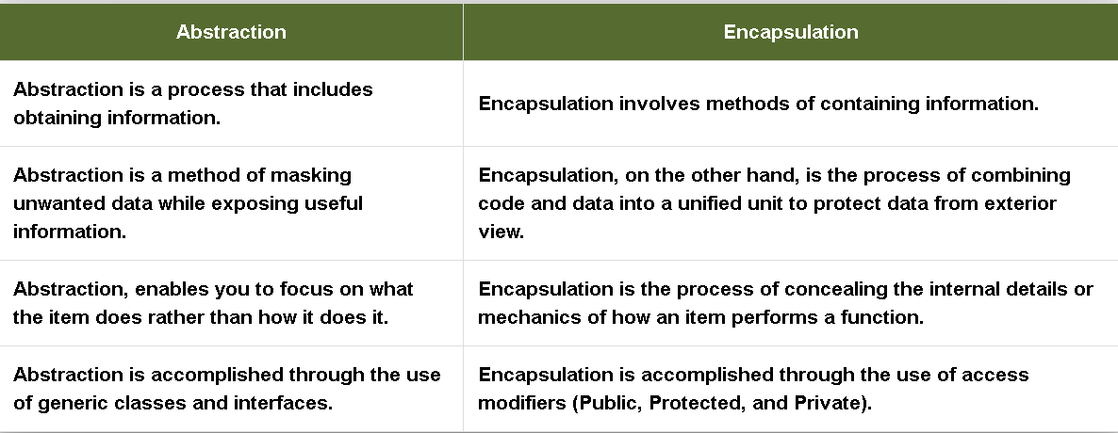

Slide 13
Advantages of Encapsulation :
Data protection
Controlled Access
Flexibility and maintenance
Enhanced security
5. Code isolation
Disadvantages of Encapsulations :
Outside of the class, private info cannot be accessed.

Slide 14
Conclusion:
Encapsulation is a fundamental concept in object-oriented programming. It essentially means binding variables and methods together into a single unit and preventing them from being accessed by other classes.

